Slide 1
Prediction of Student Result

Slide 2
Group members

Slide 3
What is WEKA?
Waikato Environment for Knowledge Analysis
It’s a data mining/machine learning tool developed by Department of Computer Science, University of Waikato, New Zealand.
Weka is a collection of machine learning algorithms for data mining tasks.
Weka is open source software issued under the GNU General Public License.

Slide 4
Main Features
49 data preprocessing tools
76 classification/regression algorithms
8 clustering algorithms
3 algorithms for finding association rules
15 attribute/subset evaluators + 10 search algorithms for feature selection

Slide 5
Datasets in Weka
Each entry in a dataset is an instance of the java class:
weka.core.Instance
Each instance consists of a number of attributes
Nominal: one of a predefined list of values
e.g. red, green, blue
Numeric: A real or integer number
String: Enclosed in “double quotes”
Date
Relational

Slide 6
WEKA: Explorer
Preprocess: Choose and modify the data being acted on.
Classify: Train and test learning schemes that classify or perform regression.
Cluster: Learn clusters for the data.
Associate: Learn association rules for the data.
Select attributes: Select the most relevant attributes in the data.
Visualize: View an interactive 2D plot of the data.

Slide 7
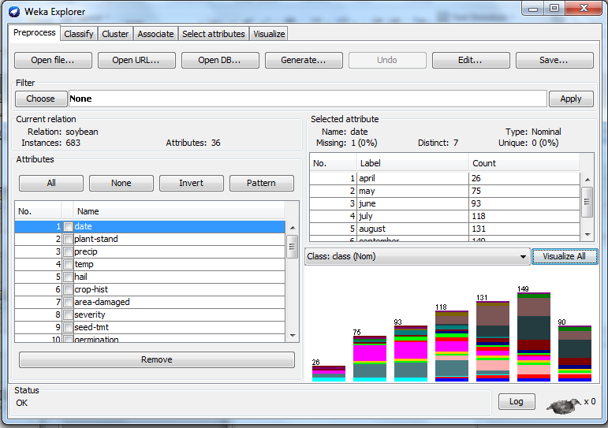
load
filter
analyze
DEMO

Slide 8
Prediction of student result

Slide 9
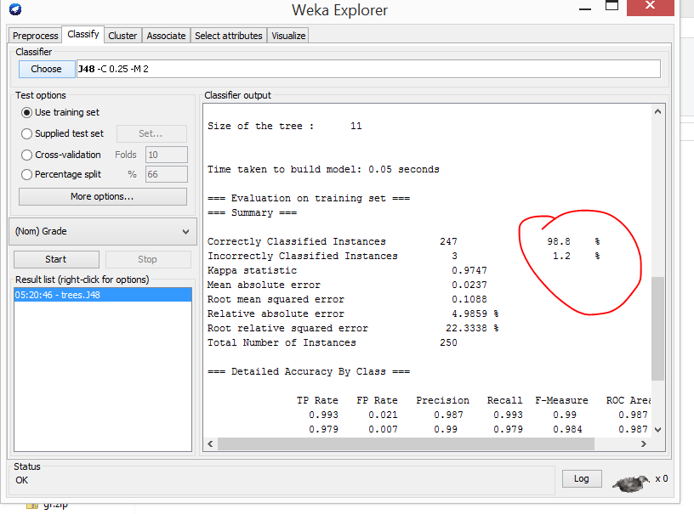
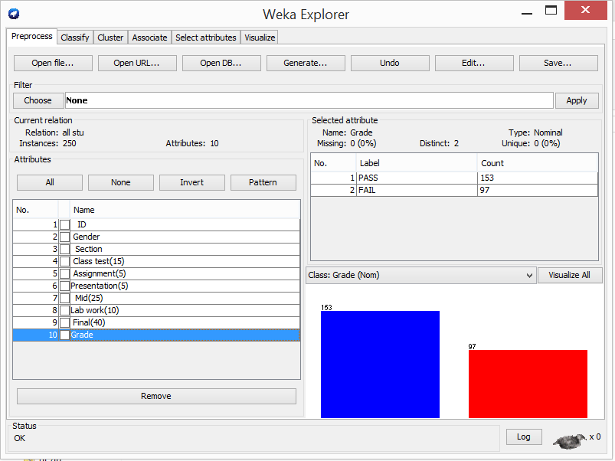

Slide 10
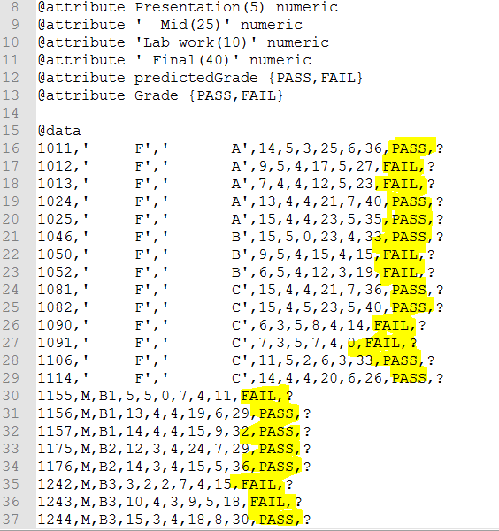
Predicted results

Slide 11
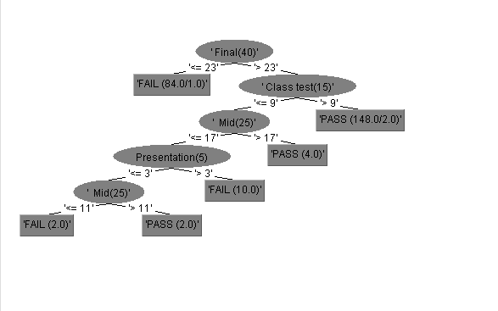
Tree for training data

Slide 12
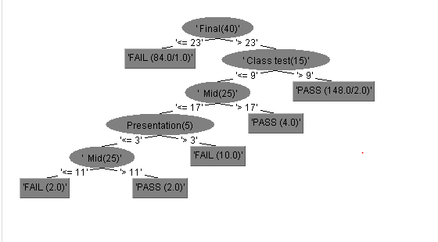
Tree for test data

Slide 13
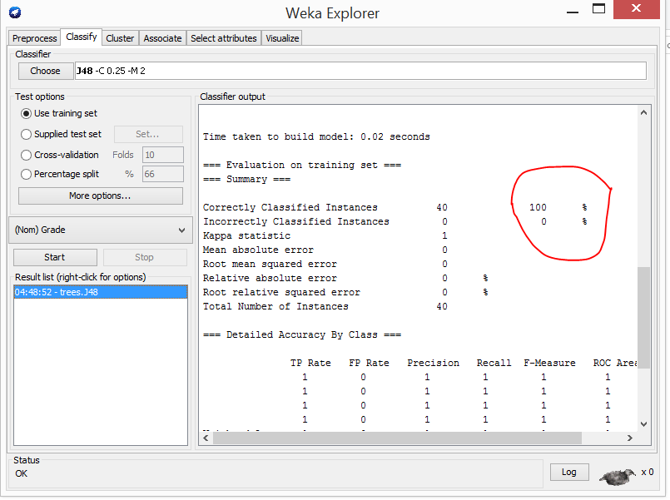
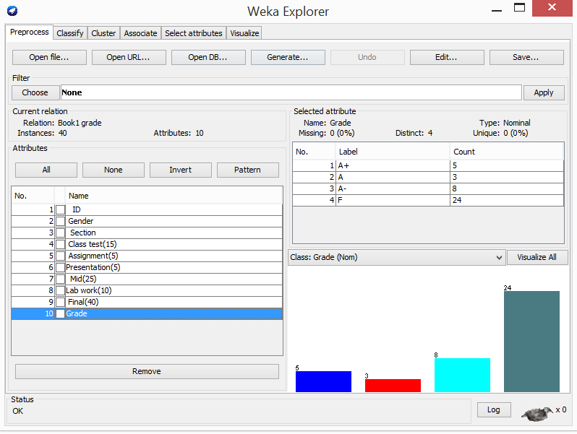
Predicted grades(training set)

Slide 14
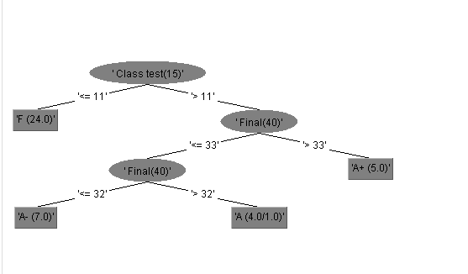
Tree For test data

Slide 15
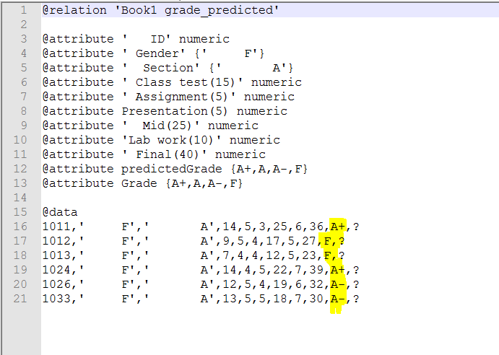
Predicted grades

Slide 16
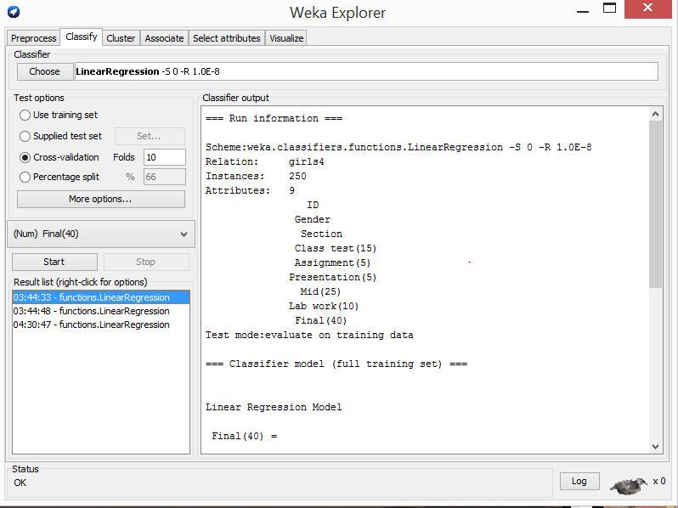
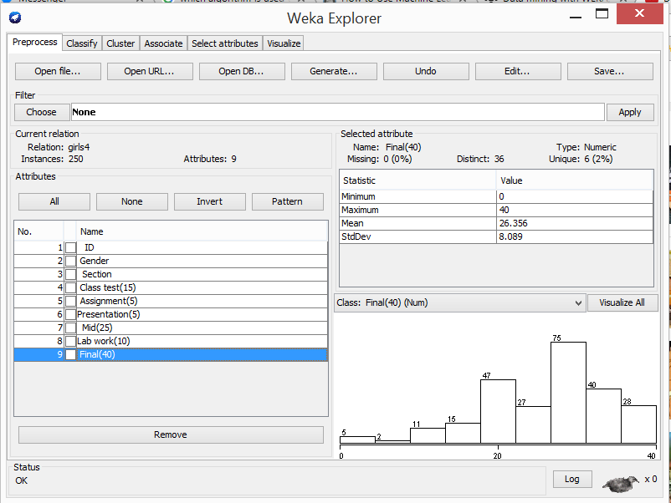
Predicted final numbers(training set)

Slide 17
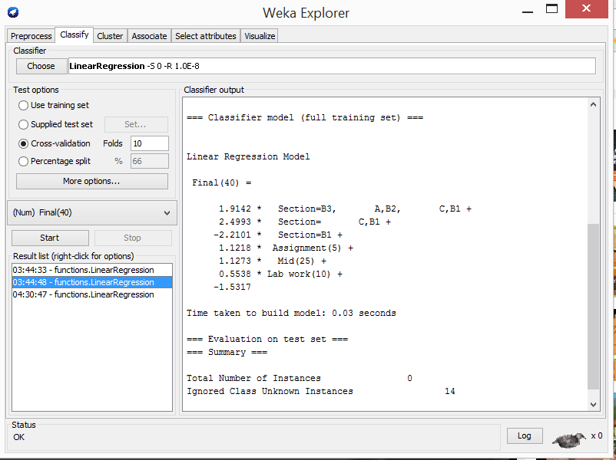
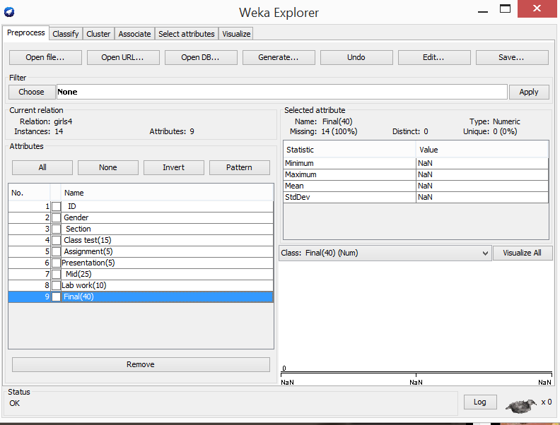
Predicted final numbers(test set)

Slide 18
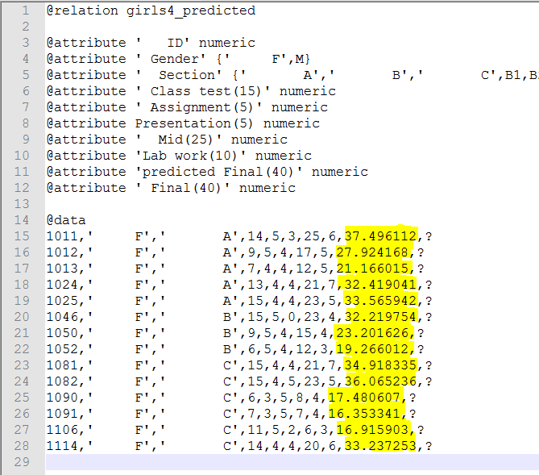
Predicted final numbers

Slide 19
THANK YOU

